Slide 1

Marijuana Pricing
Qing Huang
Sara Shafieian
Shanshan Wang
Sia Mbatia
Srijana Lawa
Yufei Gu

Slide 2
Introduction
EDA
Regression+
Clustering
Classification
Conclusion
Dataset Description
The data set tracks marijuana sales history of 117,931 transactions across 50 U.S. states between January 2012 and October 2013.
On November 16, 2012 Colorado (CO) and Washington (WA) became the first two states to legalize the recreational use of Marijuana.
Washington
Oregon

Slide 3
Introduction
EDA
Regression+
Clustering
Classification
Conclusion
Dummy for legal
Price per gram
Quality
Our variables
Income
Day Post Legal
Population
Quantity
Distance

Slide 4
Introduction
EDA
Regression+
Clustering
Classification
Conclusion
Business Question
• What factors will be important in predicting the marijuana price?
• Will the legalization of recreational use of marijuana impact
the market?

Slide 5
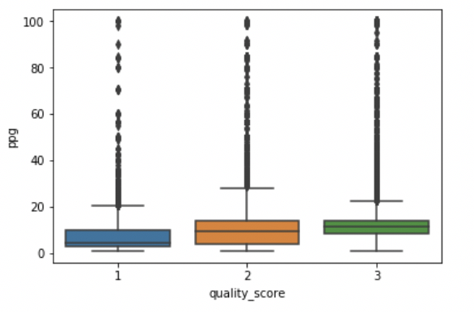
Introduction
EDA
Regression+
Clustering
Classification
Conclusion
Exploratory Data Analysis
Correlation Analysis + Visual Dashboards
Price per gram
Quantity
Price per gram
Quantity
Income
Day Post Legal
Distance
1.000
-0.341
0.035
-0.008
0.102
-0.341
1.000
0.013
0.014
-0.005

Slide 6
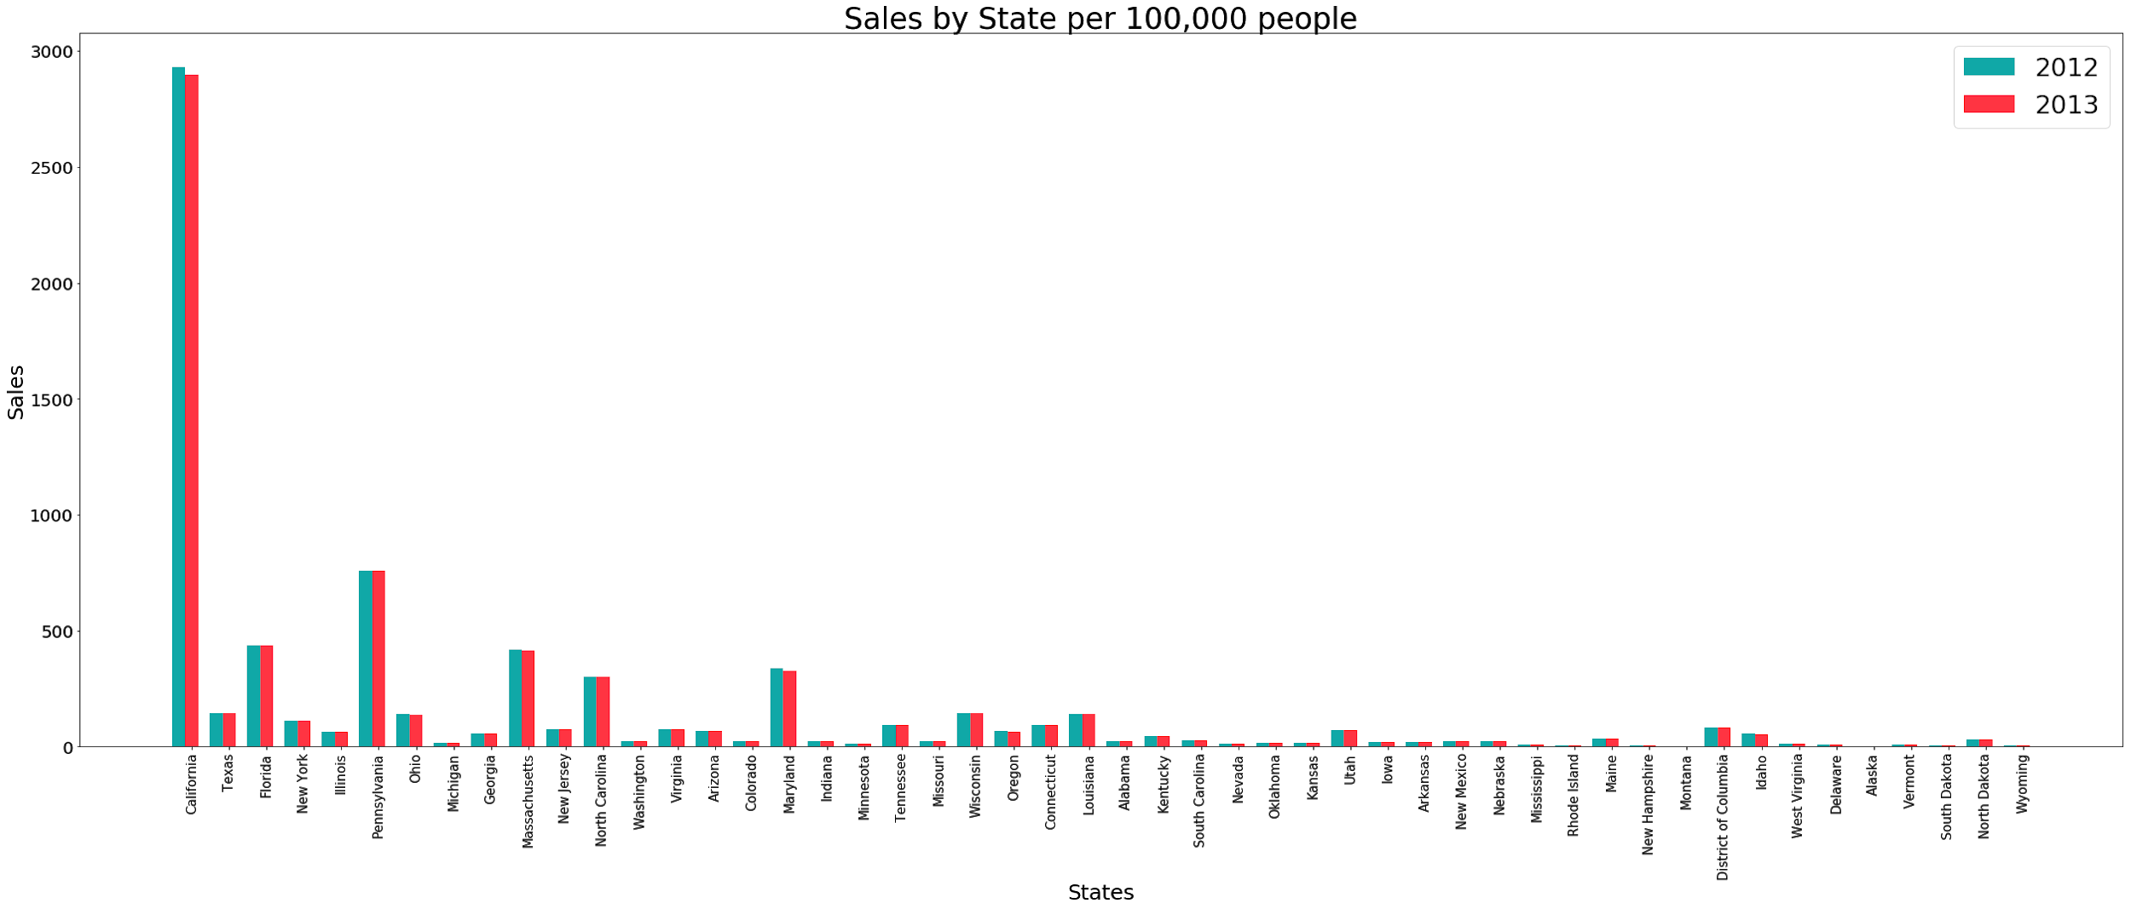
Introduction
EDA
Regression+
Clustering
Classification
Conclusion
Correlation Analysis + Visual Dashboards
California
Pennsylvania

Slide 7
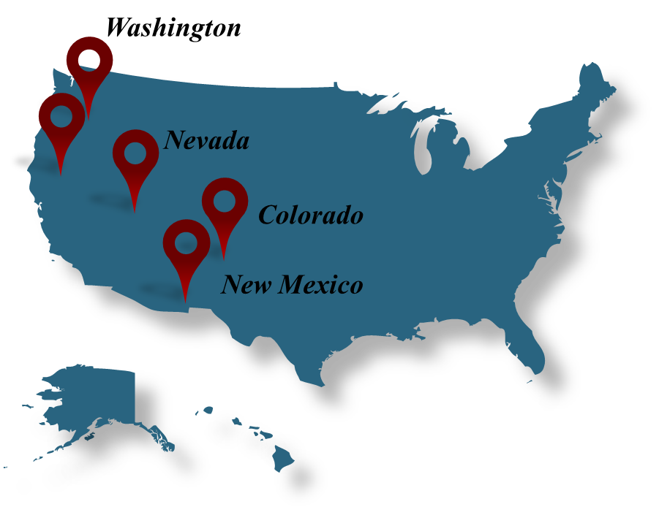
Introduction
EDA
Regression+
Clustering
Classification
Conclusion
Correlation Analysis + Visual Dashboards
Oregon

Slide 8
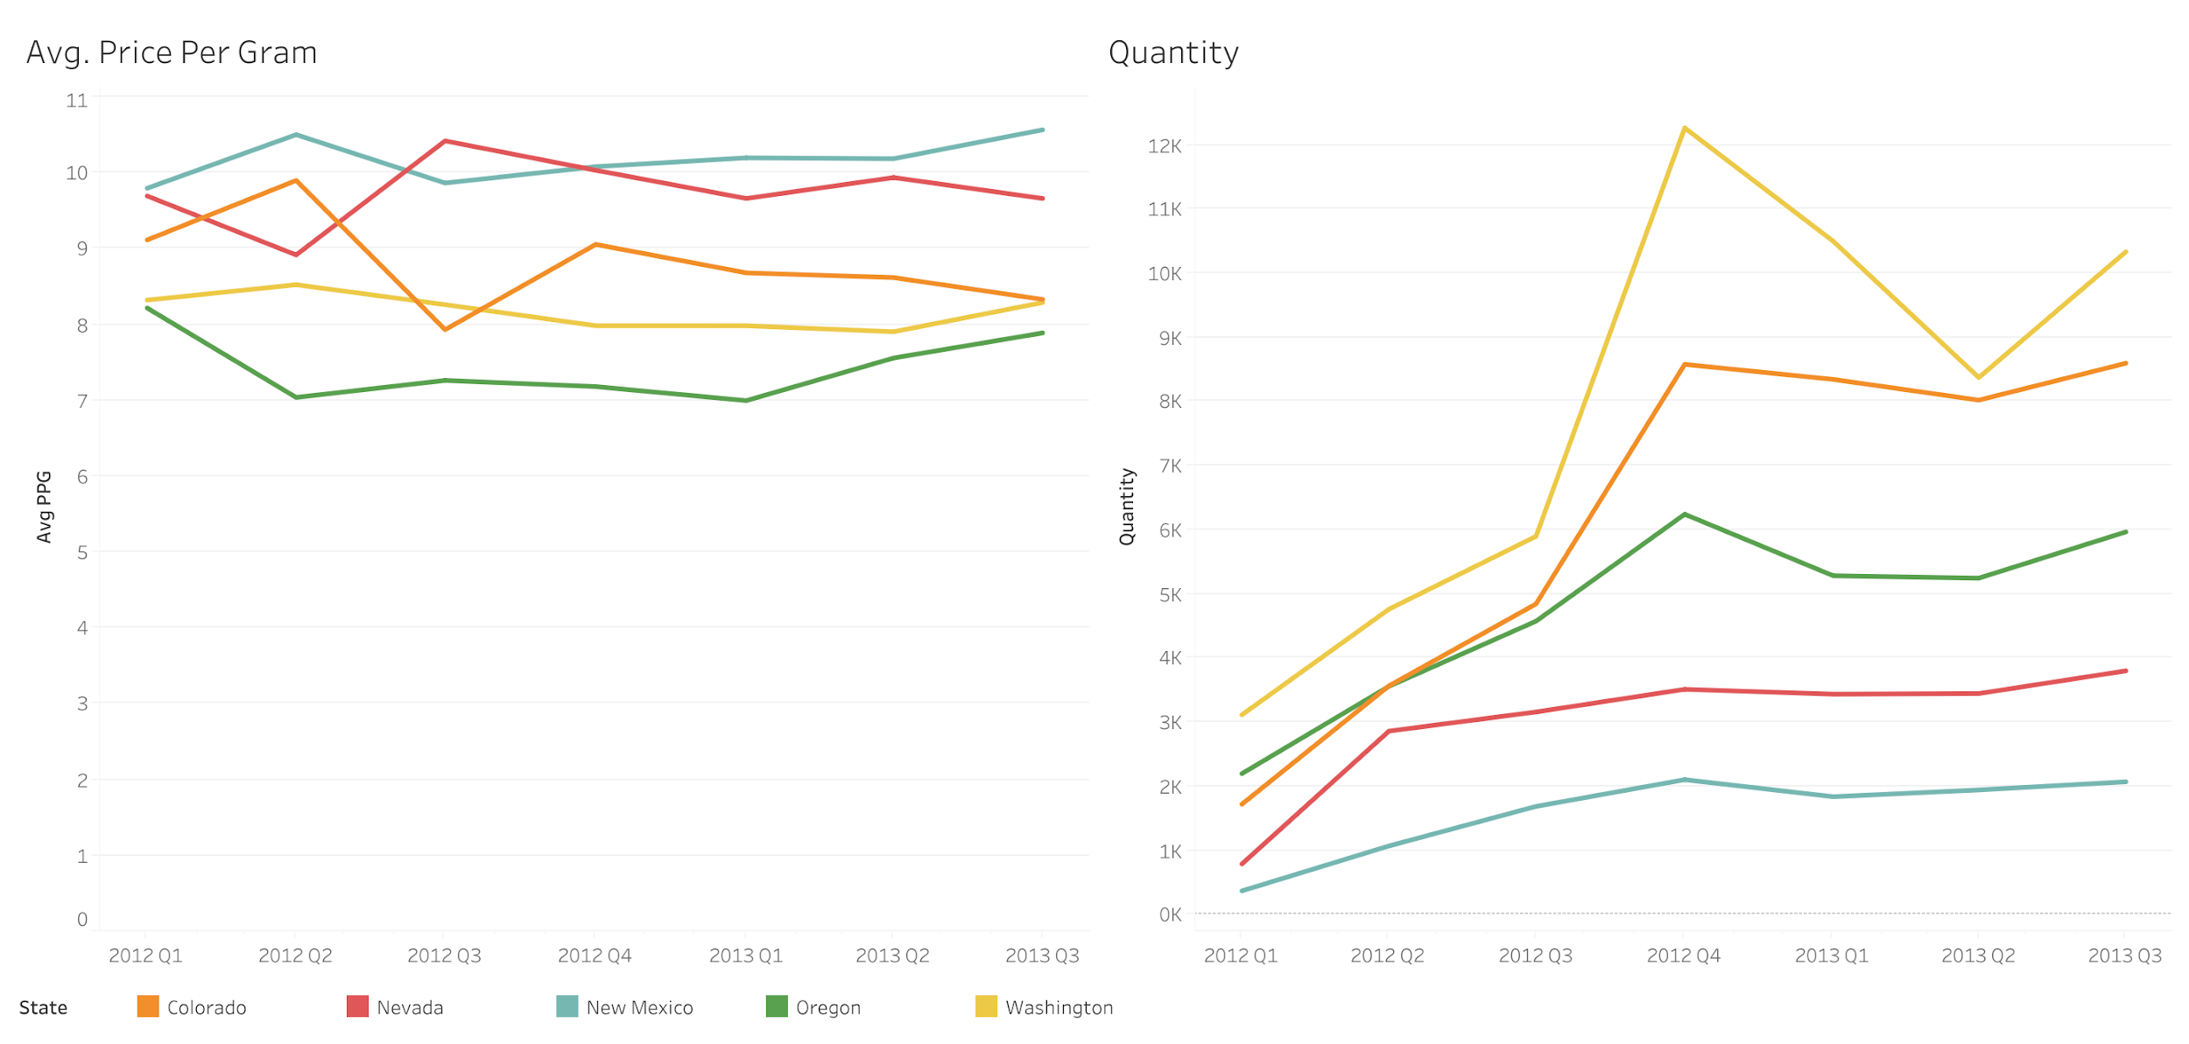
Introduction
EDA
Regression+
Clustering
Classification
Conclusion
Correlation Analysis + Visual Dashboards

Slide 9
Introduction
EDA
Regression+
Clustering
Classification
Conclusion
9 Variables + 5 States
Numerical
Days post legal
Distance
Income
Price per gram
Quantity
Quality
Oregon
Categorical
State
Legal
Year

Slide 10
Introduction
EDA
Regression+
Clustering
Classification
Conclusion
Let’s treat price per gram of Marijuana as quantitative variable!

Slide 11
Introduction
EDA
Regression+
Clustering
Classification
Conclusion
K-Nearest Neighbor
We compared mean square error of the three models for test part
Linear regression
12
11
10
K-Nearest Neighbor
Regression Decision Tree
Linear regression
Regression Decision Tree

Slide 12
Introduction
EDA
Regression+
Clustering
Classification
Conclusion
We compared the results of KNN, decision tree, and linear regression models but measures showed that our regression results were invalid.
Regression models have heteroscedasticity and residuals did not have normal distribution.

Slide 13
Introduction
EDA
Regression+
Clustering
Classification
Conclusion
We used clustering to spot any meaningful pattern in our data set.
According to clustering we need to have two clusters for our data
Quantity
Distance
Day-post-legal
Quality
MSE
Cluster 1
17.41
2053.28
72.18
2.49
40.74
Cluster 2
18.42
3327.39
63.16
2.45
24.38
Silhouette score = 0.70

Slide 14
Introduction
EDA
Regression+
Clustering
Classification
Conclusion
Neural Networks
Mean Square Error
Mean Absolute Error
Train: 9.693
Test: 10.268
Train: 2.402
Test: 2.452

Slide 15
Introduction
EDA
Regression+
Clustering
Classification
Conclusion
Now we treat price per gram of Marijuana as qualitative variable!

Slide 16
Introduction
EDA
Regression+
Clustering
Classification
Conclusion
We used binning to classify our price to two categories, High and Low
We changed our target variable to a binary variable
18
17
16
.
.
.
.
4
3
2
1
High price
Price
Cutoff point = 15
Low price
Then we used One Hot Encoding for price ….

Slide 17
Introduction
EDA
Regression+
Clustering
Classification
Conclusion
This time we use Classification decision tree because now we are dealing with binary variable for our target variable
Precision
Recall
F-Measure
High price
0.65
0.59
0.62
Low price
0.80
0.84
0.82
Accuracy score = 0.7598

Slide 18
Introduction
EDA
Regression+
Clustering
Classification
Conclusion
Variable
Importance
1
2
3
4
5
6
7
8
9
Quantity
Distance
Quality
Day post legal
Legal
State-Nevada
State-New Mexico
State-Oregan
State- Washington
0.88
0.11
0.006
0.0
0.0
0.0
0.0
0.0
0.0
Finally!
Level of importance according to the decision tree

Slide 19
Thank you for your attention

